Slide 1
Royal Greenwich Business Support & Networking Breakfast 17th May 2024

Slide 2
Pippa Hack Director of Regeneration, Enterprise & Skills

Slide 3
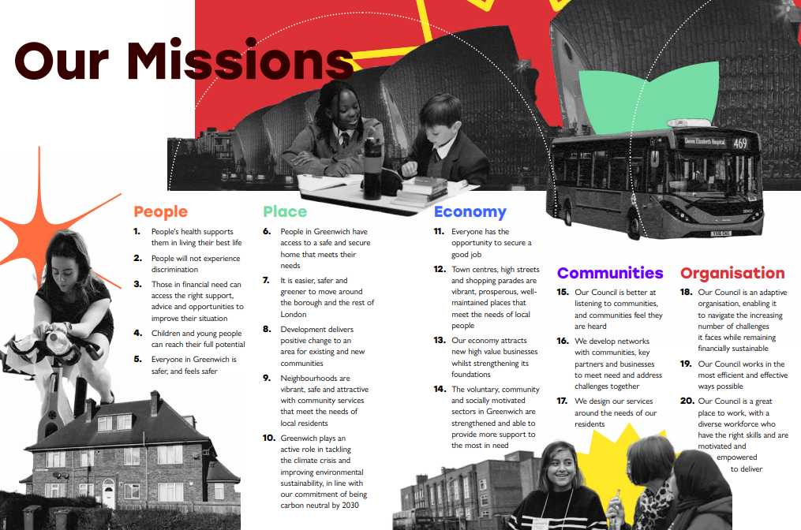
What is the UK Shared Prosperity Fund?
The UK Shared Prosperity Fund (UK SPF) - UK Government’s Levelling Up Initiative providing £2.6 billion of funding across the UK by March 2025.
The Fund aims to improve pride in place and increase life chances across the UK investing in communities and place, supporting local business as well as people and skills
Find out more about UKSPF.
Royal Borough of Greenwich allocated £2.71m over three years
Delivery guided by strategic missions set out within the "Our Greenwcih Plan
Communities which are safe, well maintained and green. .
Supporting projects to help residents to live independent, active and healthy live
Develop the conditions to nurture local businesses,and create well paid employment opportunities and making the borough a place where businesses may successfully start up and grow.
The following business support programmes are available to free to businesses operating within the Royal Borough of Greenwich, through the local allocation and pan London support provision.

Slide 4
Through the allocation of UKSPF funding to Support Local Business the following set of programmes are being delivered locally which will be running until March 2025
Business Start Up and Resilience Programme
GLL working in partnership with South East Enterprise are delivering specialist business support services to enable businesses to start up, develop and grow.
There are 2 main strands of support to the programme which is focussed towards 1) start-up businesses (less than 1 year old) to nurture new enterprise and 2) established businesses to strengthen their business resilience and sustainability.
Under the ‘Start Up’ strand, business entrepreneurs are able to get free start up support to help launch their business and will be able to access to one to one advice, workshops and webinars to help them turn their business ideas into a viable business proposition
The ‘Business Resilience’ strand provides local businesses with the guidance and advice to help them adapt to new opportunities and challenges.
The focus is on planning within the organisation such as business planning and strategic marketing planning as well as business continuity planning.
Businesses are able to access support to help them to develop a firm idea of where they need to be within the short to medium and even long term and how they will accomplish that, having a sense of where they are financially and operationally.
Support Chain Support to the SME community in the Royal Borough of Greenwich
This programme being delivered by the University of Greenwich aims to help SME’s within the local area to identify and access potential tendering opportunities arising from the current and future capital developments taking place within Royal Greenwich
There are two aspects of support being delivered through this Programme which relate to supply chain development and buyer engagement / support
Through the delivery of the project local businesses will be made aware of how large organisations including the Council procure goods and services, giving the owner or key personnel the essential knowledge to consider where they fit in supply chains and how to identify the best avenues to develop more business.
in-depth, sector specific advice will be provided to assist the businesses to respond to forthcoming tender / procurement opportunities and assistance to ensure that they are able to respond with a confident proposal which displays their suitability as an appropriate supplier.

Slide 5
3. Generative Start Up Business Support Programme
This Programme being delivered by CNT Associates supports the development of co-operative/social enterprises and help potential community entrepreneurs to put their ideas into practice with an emphasis on businesses operating in the health and social care sector
The support provision includes:
Advice on co-operative/democratic/social enterprise models and managing the business.
Development support to groups and individuals in setting up a co-operative enterprise / social enterprise which will include diagnosing needs and devising development strategies
Administration of seed funding to support business development in the form of a grant to develop the social enterprise into a viable generative business
4. Greenwich London Living Wage Grant Support Scheme
This grant scheme aims to encourage more businesses within the borough to become accredited London Living Wage employers.
As a Borough, we want to ensure that local people benefit from increased incomes, empowering them to have more control over their economic futures and improving their employment outcomes.
The Living Wage Employer accreditation strongly aligns with the shift towards inclusive economic growth and wider ambitions to have a more collaborative approach to shaping the local economy
As an incentive, the Royal Borough of Greenwich is offering a grant to locally based businesses that achieve accreditation from the Living Wage Foundation.
A grant of 3 times the annual London Living Wage accreditation fee is being offered to businesses employing less than 251 staff that commit to paying the London Living Wage for a minimum 3-year period.
Weblink: https://www.royalgreenwich.gov.uk/info/200208/business_and_licences/2410/become_a_london_living_wage_employer

Slide 7
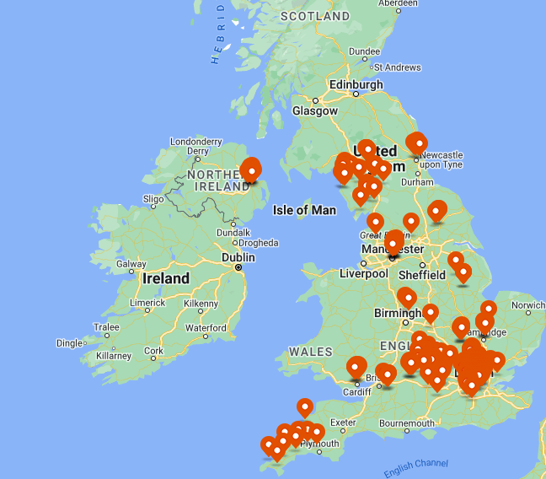
Notes:
We have been operating since 2022, and have over 250 registered members, however we have been delivering business support in the borough since 2019 since the inception of the celebrated Start Ups in London Libraries programme.
Along with South East Enterprise we hope to work with over 300 businesses, and support many businesses to create and safeguard jobs
We also work closely with other organisations such as the British Library BIPC centre to provide expert led IP support in particular, and have a good working relationships with universities, colleges and other support start up agencies,

Slide 8
Start up Greenwich is delivering the business start up and resilience programme in collaboration with South East Enterprise.
We will be working with aspiring entrepreneurs and businesses to help them start and develop their business.
We do this through the provision of: webinars, workshops, 121 business advice sessions, networking events, training sessions, opportunities to trade/test business ideas and much more.
Our office is based in Woolwich Centre Library, which is also a business lounge.
We deliver events across the Royal Borough of Greenwich through our network of libraries.
Notes:
We have been operating since 2022, and have over 250 registered members, however we have been delivering business support in the borough since 2019 since the inception of the celebrated Start Ups in London Libraries programme.
Along with South East Enterprise we hope to work with over 300 businesses, and support many businesses to create and safeguard jobs
We also work closely with other organisations such as the British Library BIPC centre to provide expert led IP support in particular, and have a good working relationships with universities, colleges and other support start up agencies,

Slide 9
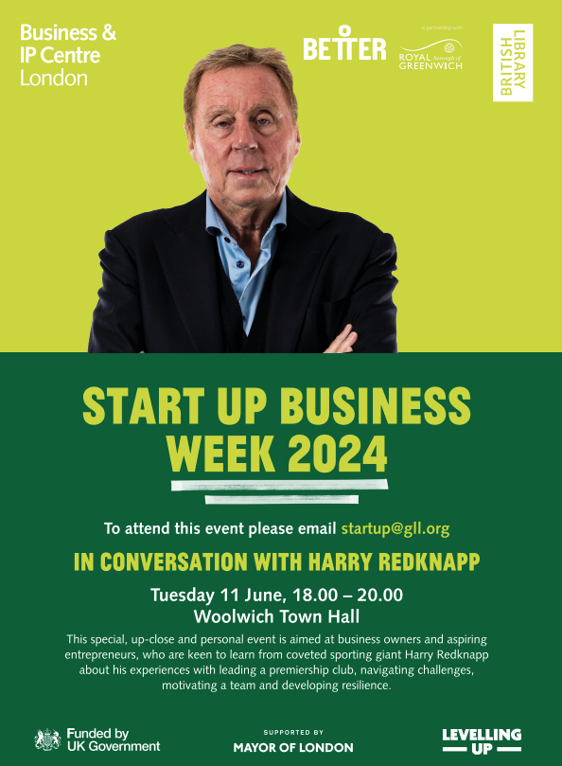
Using Social Media to Generate Leads – Monday 10th June, Woolwich Centre Library (11am to 1pm)
Greenwich Business Day –Tuesday 11th June, Greenwich Centre Library (10am to 4pm)
How to turn your side hustle into a business – Wednesday 12th June, webinar, 10.30am to 12.30pm.
Building an online presence for your creative business – Thursday, 13th June, Woolwich Centre Library, 11am to 1pm.
Visit: better.org.uk/start-up-business-week to register your attendance.
Notes:
In terms of what you can look forward to, we are proud to deliver our third cross borough Start Up Business Week and we have an exciting line of business experts, successful local business owners and celebrity speakers to provide inspiration, motivation and guidance.
We are particularly proud to be hosting Harry Redknapp on Tuesday 11th June at Woolwich Town Hall 6pm to 8pm. I'll be having a fireside chat with him, and it will be focused around resilience, leadership, motivating teams and navigating challenges. All greenwich businesses and aspiring entrepreneurs are welcome. If you would like to attend, and find out more about the support we are offering, we have a stand at the back, and you can come and speak to myself and my colleague J.

Slide 10
Loretta Awuah – loretta.awuah@gll.org
Jawahir Sheikh – jawahir.sheikh@gll.org
Start Up Greenwich mailbox – startupgreenwich@gll.org
Start Up Greenwich website: better.org.uk/start-up-greenwich
Notes:
We have been operating since 2022, and have over 250 registered members, however we have been delivering business support in the borough since 2019 since the inception of the celebrated Start Ups in London Libraries programme.
Along with South East Enterprise we hope to work with over 300 businesses, and support many businesses to create and safeguard jobs
We also work closely with other organisations such as the British Library BIPC centre to provide expert led IP support in particular, and have a good working relationships with universities, colleges and other support start up agencies,

Slide 11
Royal Borough of Greenwich Business Start Up
and Resilience Programme

Slide 12
South East Enterprise (SEE) are working with Start Up Greenwich to deliver the
Business Start Up and Resilience programme
SEE is delivering support to SMEs to build their resilience
through 1-2 -1 support, webinars and events
SEE has been delivering a wide range of
business support in Greenwich for over 20 years

Slide 13
We work with local SMEs providing one to one support to help build resilience
We will work on planning for sustainability
SMEs have access to an ongoing programme of webinars including:
digital marketing and content planning
Business continuity planning
Financial planning/cash flow forecasting and more

Slide 14
LONDON E-Business Support Programme
Empowering businesses to embrace digital and thrive!

Slide 15
Pan-London Delivery by
Business for London Consortium: 7 Partners

Slide 16
LONDON E-Business Support Programme Impact for Individual SMEs
Enhance digital knowledge & skills
Boost effectiveness of online marketing – maximise sales
Increase productivity and improve efficiency through adoption of digital tools
Save time and money
Increase turnover
Become more sustainable

Slide 17
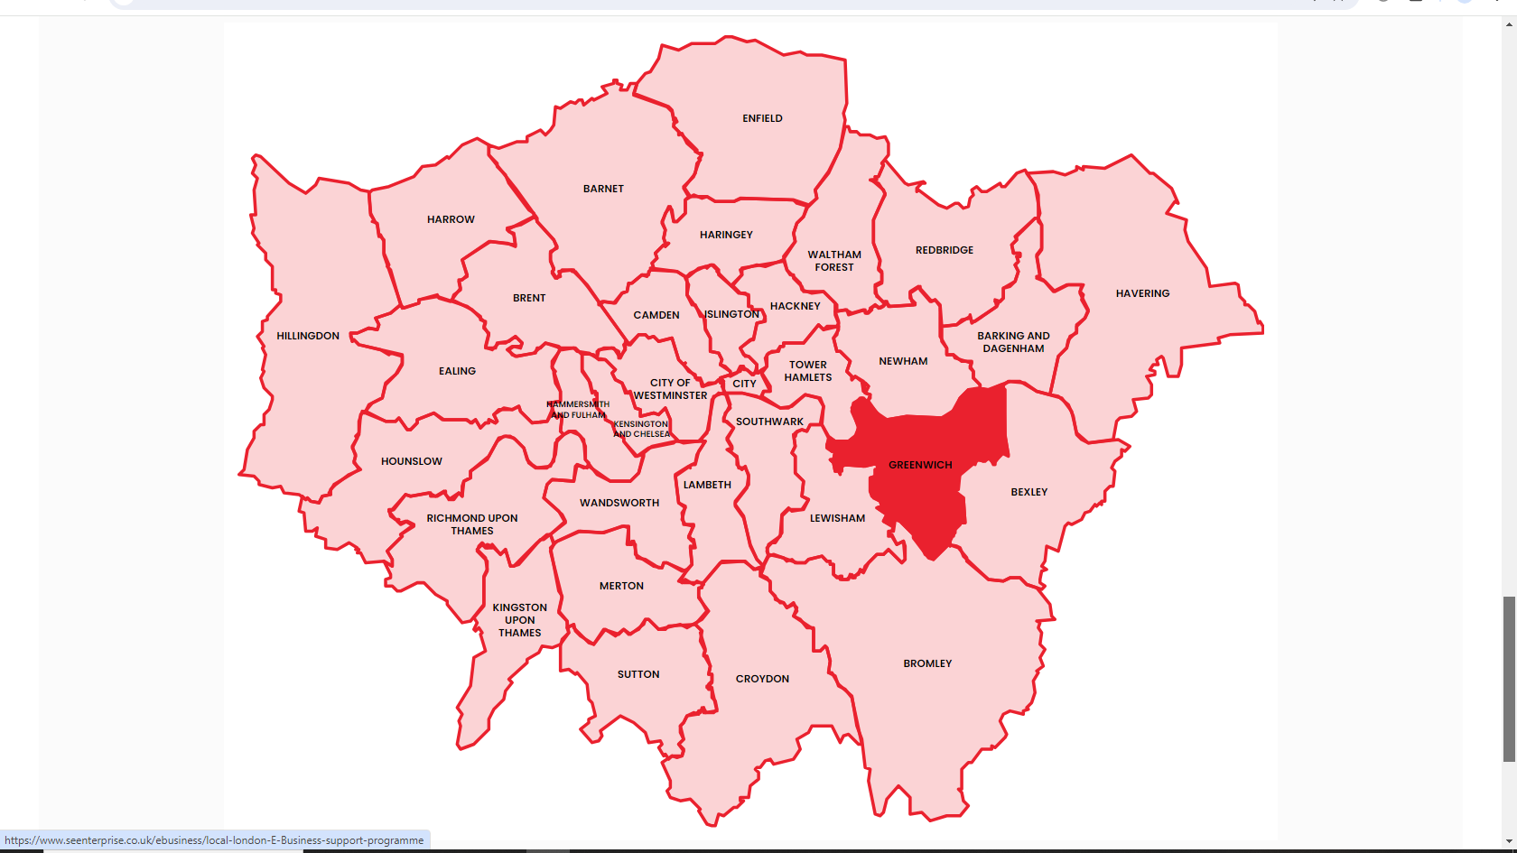
The E-Business programme delivers
Across all London Boroughs

Slide 18
How Businesses Register
For businesses based in Greenwich
South East Enterprise:
www.seenterprise.co.uk
Tel: 020 8305 2666
Our offices and training suite are in Woolwich

Slide 19
Dr Wenxian Sun Associate Professor in Project Management Associate Head Research and Knowledge Exchange

Slide 20
Supply Chain Support (SCS) to SME Community in the Royal Borough of Greenwich
The Royal Borough of Greenwich has appointed the University of Greenwich to deliver a supply chain support programme aimed at nurturing the growth and resilience of businesses within the borough
This initiative is about fostering a thriving ecosystem for entrepreneurship and sustainability within our community which aims to see the initial outcomes by March 2025.
Why Participate?
If you are a business within the Royal Borough of Greenwich, by signing up for the SCS project, you open the door to a myriad of opportunities
Access to Tendering Opportunities: Gain insight into potential tendering opportunities within the Royal Borough of Greenwich, positioning your business as a qualified contractor ready to contribute to our vibrant local economy.
Tailored Support Services: Upon registration, you'll be contacted by the University to assess your current capabilities and identify areas for improvement. From there, you'll receive personalised training, mentoring, and coaching to help you reach your full potential.
Inclusive Business Environment: The SCS project is committed to inclusivity, offering support to under-represented groups such as young entrepreneurs, women in business, and BAME enterprises. We believe in creating an environment where everyone has the opportunity to succeed.
How to Sign Up:
Simply click the link below and fill in the online registration form with your contact details which should take you no longer than 3 minutes. It's that easy!
https://forms.office.com/e/qUadGU1Wvi
For further information regarding the programme please visit https://www.gre.ac.uk/bus/ebc/knowledge-exchange/supply-chain-support

Slide 21
RBG Generative Business Support Programme
In partnership with RBG, funded by UK Government’s Shared Prosperity Fund
www.cntassociates.com

Slide 22
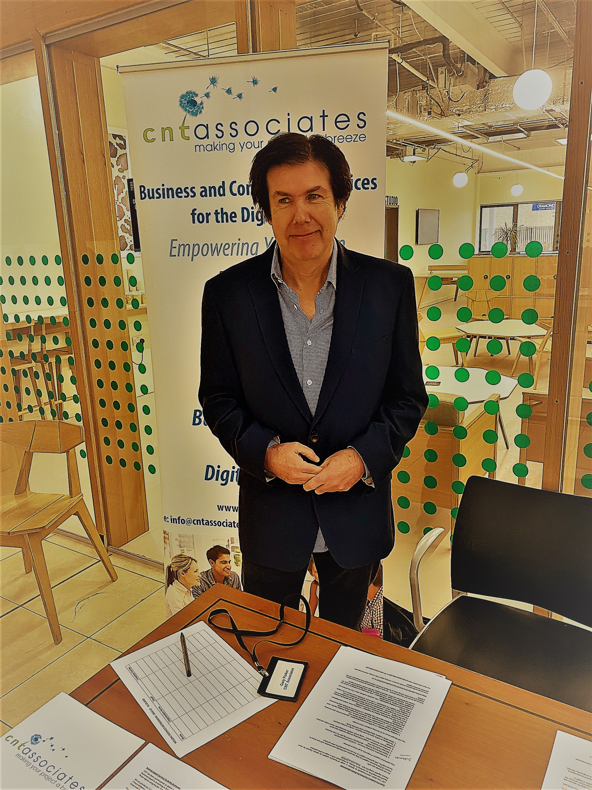
About CNT
Locally based provider of business support,
fundraising and training.
Established in 2003, worked with over
5,000 businesses and charitable organisations.
Raised over £10 million for clients
Members of FSB, IoF IED and have achieved
‘Safe Supplier’ quality standard
E gary.parker@cntassociates.com
www.cntassociates.com

Slide 23
What is the RBG Generative Business Programme ?
- A free government funded programme of support for up to 40 businesses with a social or environmental purpose- funded by the UK Shared Prosperity Fund and managed by RBG. There is also a small grant programme by application, to support up to 25% of participants
- Who is it focused on ? Businesses, charities and start - ups who wish to develop or provide services that directly benefit the community with a social or environmental purpose , with a strand of support for health and social care businesses
- How does it work ?
CNT with support from RBG is identifying suitable candidates for the progamme, a customised programme of business support is then developed and delivered

Slide 24
What Progress Have We Made So Far ?
This programme become operational recently but already:
We have recruited 16 participants to the programme
These include 4 health and social care organisations/ startups, a heritage organisation, a business support organisation and a startup purchase and supply organisation
We are developing action plans, delivering 1-2-1 support and guidance staff development training, advising on business models, researching potential funders and giving funding advice, providing digital support and advising on potential partnership opportunities.
We are also developing a range of tools and resources for participants, including a range of webinars/ presentations and other presentations and documents which will be available on our YouTube Channel and via our website.

Slide 25
How Will The Programme Develop?
-The programme will roll out until 31st March 2025
- We will provide a customised progamme of support based on the development needs of the participants.
- We will provide both in person and digital support and access to a range of resources 24/7.
- Participants will be able to become ‘case studies’ for the programme if they wish to help us promote them and to support the development of other generative businesses in RBG.
- CNT are locally based and we wish to provide legacy support beyond the life of the programme ,by utilising technology and building local infrastructure and partnerships.

Slide 26
ANY QUESTIONS ?
CONTACT US LATER?
Call us on 020 8320 1360 or email us on info@cntassociates.com
Or join Gary Parker on
Linkedin - https://www.linkedin.com/in/gary-parker-cnt1/
For more information on any of our workshops please visit:
http://www.cntassociates.com/newsandevents.asp
See our YouTube Channel - with free funding video access
https://www.youtube.com/channel/UCb2GAUq8KyUeWKPOSh_q_yA
Twitter - @CNTAssociates
Instagram @cntassociates

Slide 27
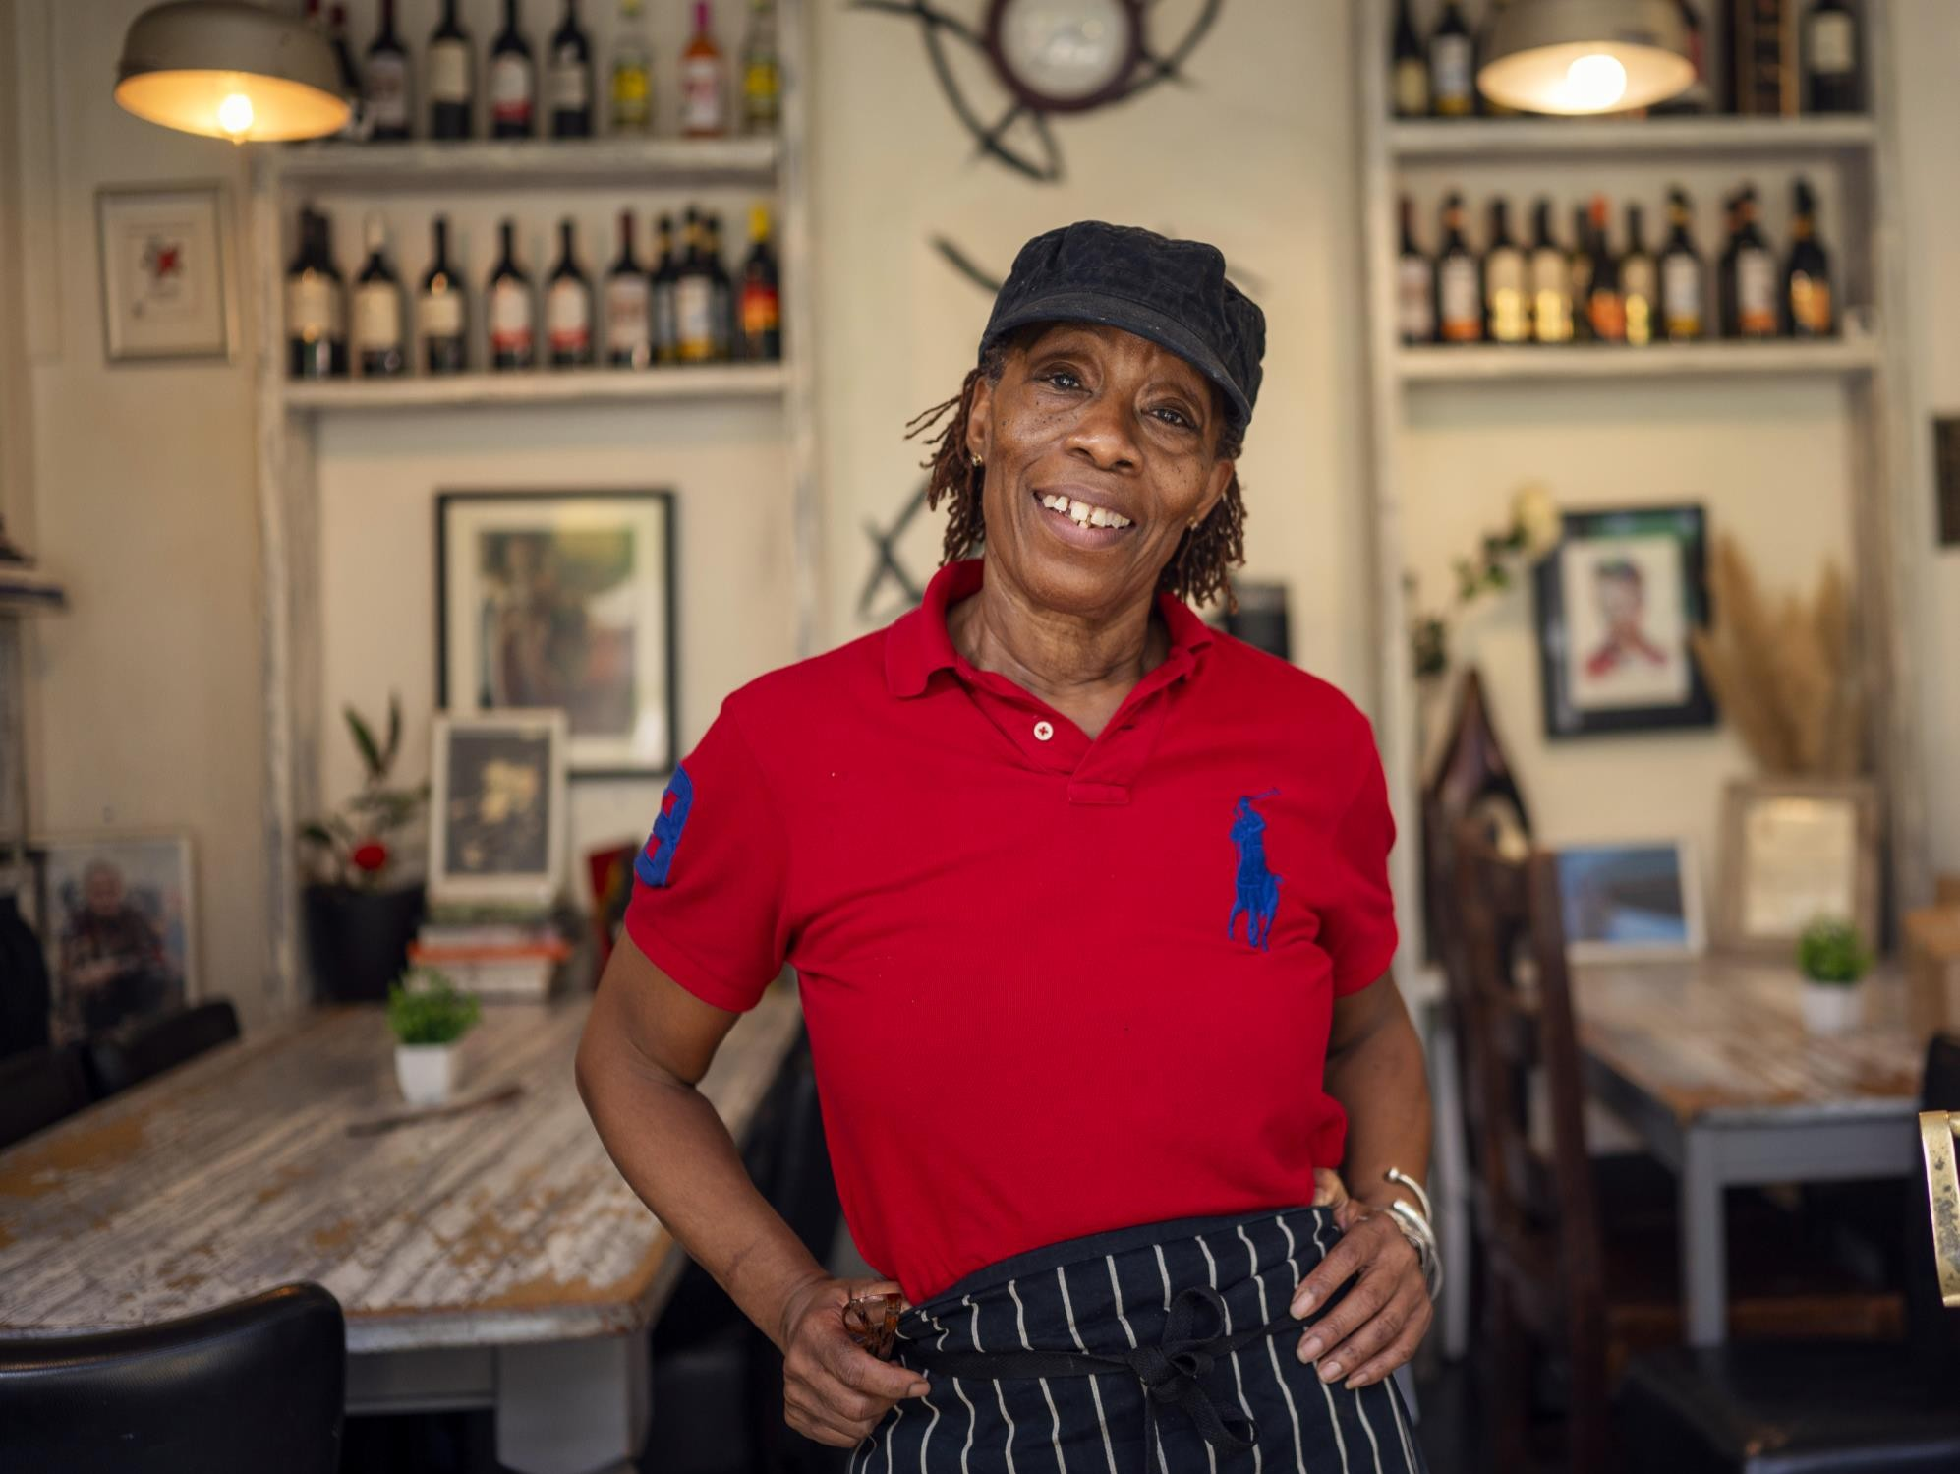
ONE PLACE TO ACCESS SUPPORT

Slide 28
Our vision is that every micro and small business in London can get the support they need to thrive

Slide 29
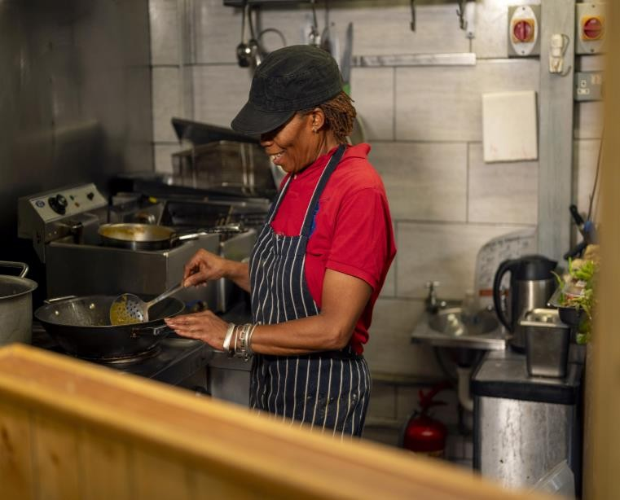
What is Grow London Local?
Grow London Local is the Single Front Door to business support for London's small and micro businesses.
It's the one place to get free access to everything you need to help your business to thrive.
Whether you’re a hairdresser, wholesaler, mechanic or any other small business owner, we'll navigate you to the most timely, relevant support for your business.
Grow London Local is delivered by London & Partners, funded by The UK Shared Prosperity Fund (UKSPF), and supported by the Mayor of London

Slide 30
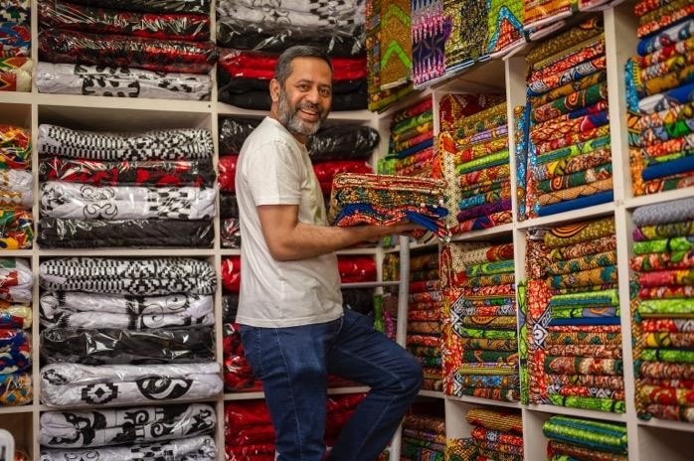
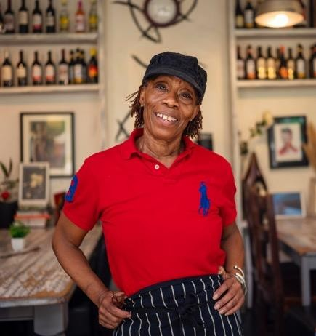

Slide 32
One place for business support
We will navigate micro and small business owners to support; helping their households to become financially resilient.

Slide 33
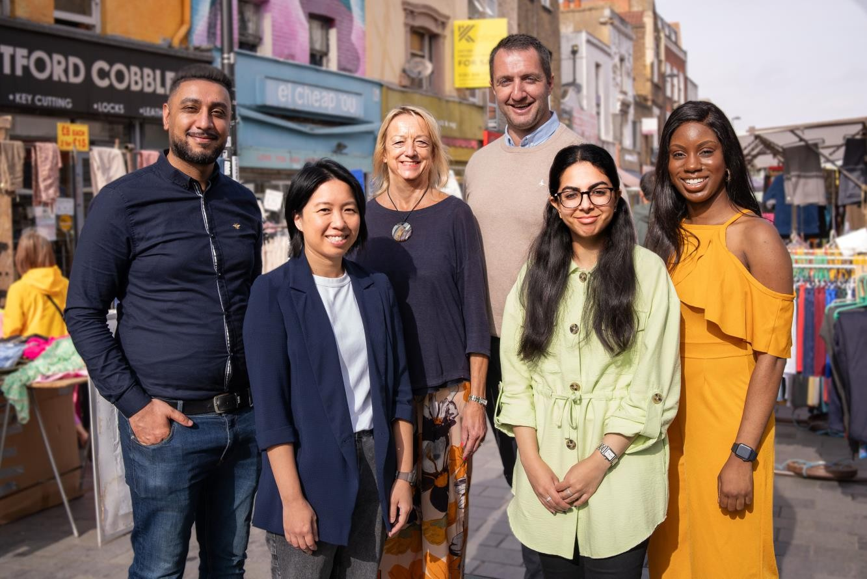
Our community team
Our business support team help businesses to understand what they need, what is available, and make referrals to relevant service providers.
They are available for in-person, phone, video call, by appointments or drop-in sessions.
They will be out and about in your community, from high streets, to markets, to industrial estates.
Book an appointment: growlondonlocal.london/support

Slide 34
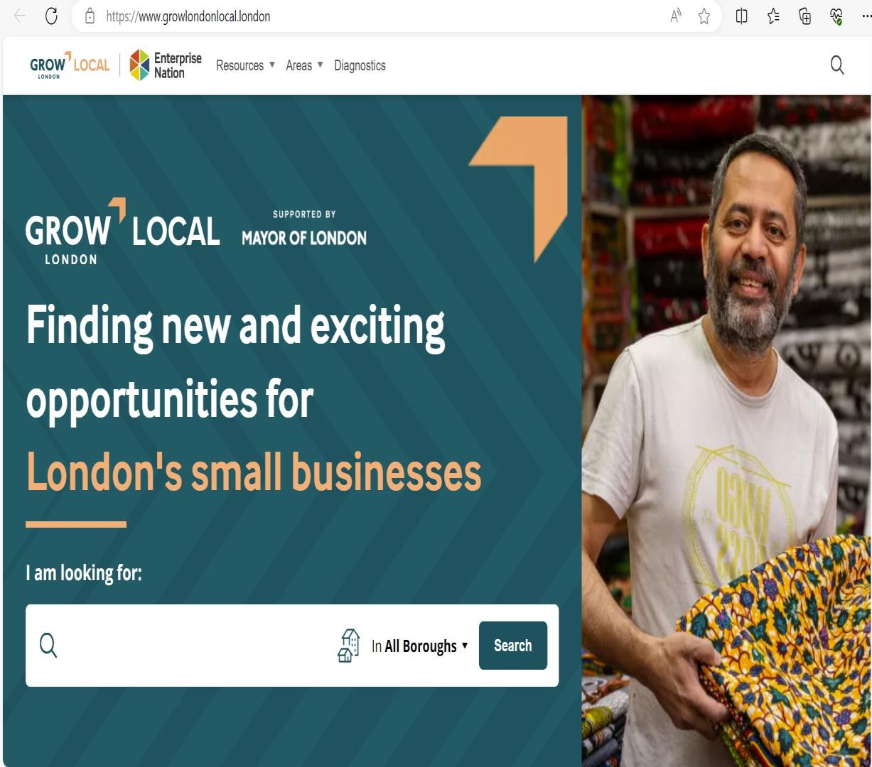

Slide 35
SERVICE PROVIDERS

Slide 36
PHASE 1: Broad
PHASE 2: Deep
We are building a critical mass of high-quality service providers and business
support providers.
Public Sector &
Publicly Funded
GLA
Boroughs
Borough Delivery Partners UKSPF Providers
Trial Pilot Partners
PHASE 3: Focused
Public Sector & Third Sector
Membership orgs Trade Associations Chartered Institutes Universities London BIDs
SRPs
Growth Hubs
Dept Business & Trade
Private Sector
Phased industry-focus acquisition campaigns
Targeted recruitment of:
Market leaders within SME support services
Professional sector networks & communities
Community outreach organisations
Invitation to Register
(Sept ’23 - Mar ‘24)
Self-registration
(April onwards)

Slide 37
GROW
LO N D O N
THANK YOU

Slide 38
Monalisa Saha Programme Manager Living Wage Foundation monalisa.saha@livingwage.org
Notes:
More celebratory styled slide

Slide 39
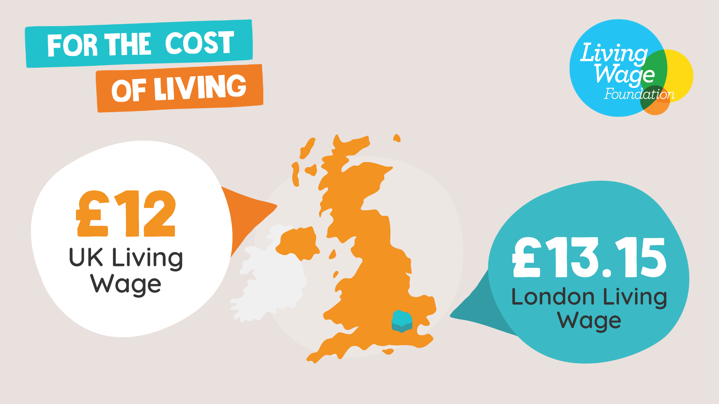
Notes:
Static version of new rates

Slide 40
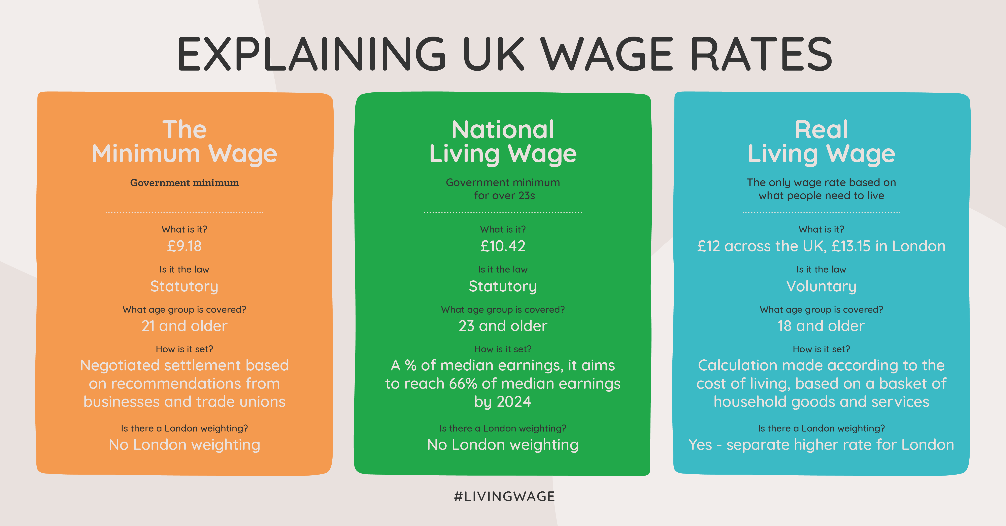
Notes:
It’s important to know the difference!
The real Living Wage is independently calculated every year based on what employees and their families need to get by.
It’s a calculation is based on a social consensus of what people need for a decent standard of living and to participate fully in society.
It’s uprated annually and overseen by The Living Wage Commission who oversee the calculation to ensure they are fully representative of life in the UK today and based on the best available evidence about living standards.
The real Living Wage includes a separate rate that reflects the higher costs of living in London, in the same way London weighting does.
It applies to all workers over 18 – in recognition that young people face the same living costs as everyone else
The NLW is based on a target to reach 66% of median earnings by 2024 (wage based) whereas the real Living Wage is based on the cost of living (needs based)

Slide 41
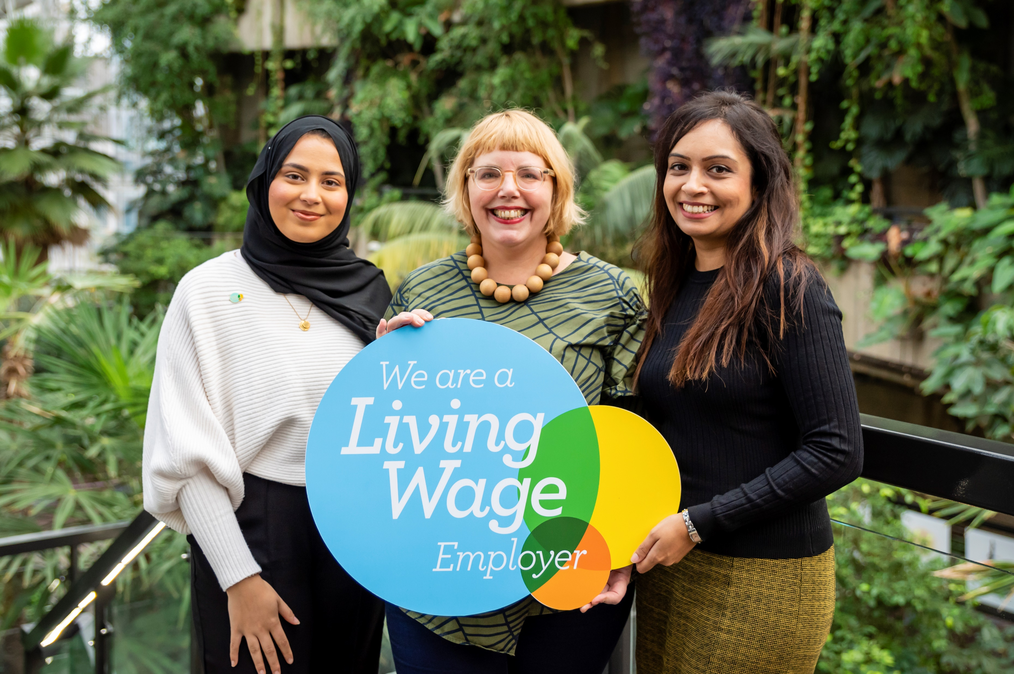
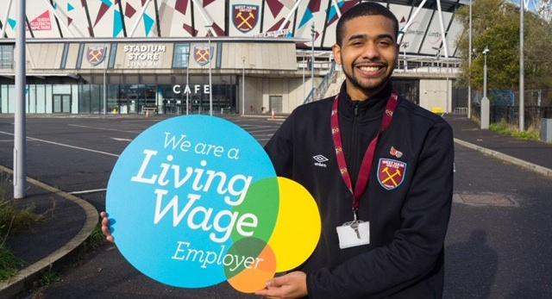
Title Name Position Living Wage Foundation
Our movement has…
Put £3bn back into the pockets of low paid workers.
Lifted over 460,000 workers onto the real Living Wage
Has almost 15,000 accredited Living Wage Employers
Notes:
Movements impact V1

Slide 42
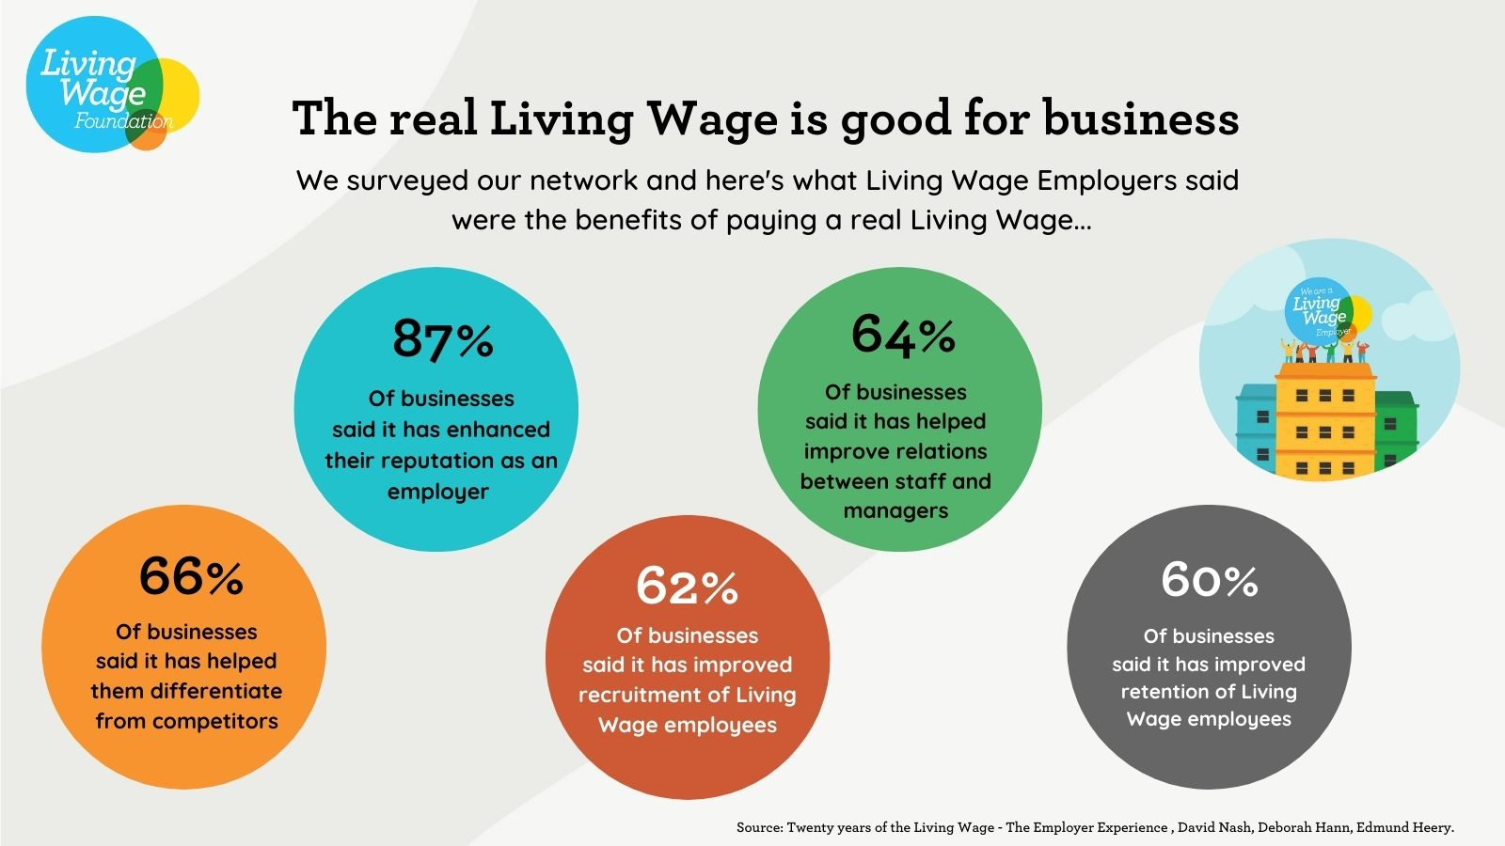
The Living Wage is good for business
Notes:
There is a strong business case for adopting the real Living Wage too
This slide illustrates some key outcomes from a survey we did in 2021 with our Living Wage employers (with thanks to Cardiff Business School):
Rather than talk through them, I’ll leave this to you.
Employers are choosing to do this with the intention of raising standards in pay for staff, investing in job quality which then sees a return.
There is increasing evidence that Living Wage employers experience improved recruitment, retention, motivation and quality of work, which ultimately contributes to higher productivity.
Workers are happier and more loyal and committed to an organisation that invests in them and treats them with dignity and respect.
80% of employers felt that the Living Wage had increased consumer awareness of their commitment to be an ethical employer
When KPMG after adopting the LW they saw:
Fewer day to day complaints going to their helpdesk
Reduction in staff turnover and churn
Improved quality of service for staff and visitors with an increase in morale and increase of Loyalty to KPMG as their employer where
Improved relationship between them and their FM service provider ISS at the time, and overall cost savings made that could be reinvested into the contract
*Not just big businesses, 80% of our accredited network are actually SMEs and report very similar findings, we’ll hear more from one later in this webinar.
Next slide please
________________________________
Current approx. duration: 1m20s

Slide 43
What is Living Wage Employer accreditation?
Mark of a responsible employer
Accredited Living Wage employers commit to:
pay all directly employed staff the Living Wage
having a plan in place to roll the Living Wage out across third party contracts as they come up for renewal, usually over 2-3 years.
The Living Wage applies to people who deliver services on the premises e.g. catering, cleaning, security

Slide 44
London Living Wage Grant Support Scheme
The Royal Borough of Greenwich is offering a one-off grant covering the first 3-years of accreditation fees for all newly accrediting organisations with less than 250 employees.
To access the grant, employers must commit to pay all their directly and sub-contracted staff at least the LLW rate and show their commitment by accrediting through the Living Wage Foundation.
Once accredited, complete the Royal Greenwich grant form.
Click here to learn more and complete the grant application form
Notes:
Reporting progress annually to the Foundation enables us to understand the number and percentage of staff that are lifted to the Living Wage as a result of being part of this scheme
Our best growth seen cleaning companies move from having 20% of staff on Living Wage contracts up to 80% in 2 years
Peartree cleaning, a family orientated cleaning business have compared their LW contracts to all those that pay below and see a 98% retention on LW contracts in comparison to a 75% retention rate overall.
A survey from last year reported that 30% of the employer network are actively contracting with our Recognised Service Providers (bearing in mind the scheme was new and there were under 60 to work with)
We are now working with many of our largest organisations are asking whether contractors are part of the movement in Pre-Qualification Questionnaires and in sustainability practices too.

Slide 45
BECOME A LIVING WAGE EMPLOYER AND WE WILL COVER THE COST OF ACCREDITATION
Click here to find out more
PAYING THE REAL LIVING WAGE IS GOOD FOR YOUR EMPLOYEES, YOUR BUSINESS AND SOCIETY.
By paying the real Living Wage, employers are ensuring that their staff are earning enough to live on. Gaining the Living Wage Employer accreditation demonstrates your commitment to fair pay to your employees, existing and new customers and potential funders. As a proud Living Wage Employer since 2017, we are offering grants to cover the cost of accreditation for three years for businesses in the Royal Borough of Greenwich.
EMPLOYERS WHO PAY THE REAL LIVING WAGE:
see reduced absenteeism and sick leave
receive a better quality of applications for jobs find it easier to recruit and retain staff
see a huge boost to staff morale and productivity
see improved brand awareness.
secure more contracts and funding
94% of businesses surveyed benefitted from accreditation
Are you ready to join more than 14,000 UK employers who are accredited Living Wage Employers?
Notes:
Reporting progress annually to the Foundation enables us to understand the number and percentage of staff that are lifted to the Living Wage as a result of being part of this scheme
Our best growth seen cleaning companies move from having 20% of staff on Living Wage contracts up to 80% in 2 years
Peartree cleaning, a family orientated cleaning business have compared their LW contracts to all those that pay below and see a 98% retention on LW contracts in comparison to a 75% retention rate overall.
A survey from last year reported that 30% of the employer network are actively contracting with our Recognised Service Providers (bearing in mind the scheme was new and there were under 60 to work with)
We are now working with many of our largest organisations are asking whether contractors are part of the movement in Pre-Qualification Questionnaires and in sustainability practices too.

Slide 46
Thank you!

Slide 47
RBG The Business Team
The Business Team, working alongside the Royal Borough's Business Support network (including those listed below) provides the Royal Borough of Greenwich's primary point of contact for aspiring entrepreneurs, start-ups, existing businesses and relocating businesses seeking to access available business support.
The key priorities of the Team are to :
1. Develop innovative actions and mechanisms to support enterprise and growth
2. Create the conditions for business growth
3. Co-ordinate available business support provision
4. Secure benefit for new and existing local business from major development
Beyond sister Services within the Council, we work in partnership with a wide range of external partners such as the South East London Chamber of Commerce, the FSB, enterprise agencies, the HE/FE sector, traders’ associations, developers and private sector business support providers to develop innovative mechanisms to support businesses to thrive. Working together, through the Greenwich Business Support Partnership, we seek to create the best environment to start up, grow, attract and retain businesses in the borough
Working closely with Grow London Local, the team provides a signposting / referral service to make Greenwich residents and businesses aware of the available business support to local businesses
The Business Team also deals, locally, with inward investment and business retention enquiries. The team has access to a commercial property database system to supply up to date information on all commercial premises in the borough. Premises enquiries can be made directly to the Business Team at business@royalgreenwich.gov.uk
Alternatively, service users may access the online premises search facility at https://www.royalgreenwich.gov.uk/info/200218/business_support_and_advice/224/locating_your_business_in_royal_greenwich

Slide 48
Royal Greenwich Business Support & Networking Breakfast 17th May 2024
Contact us at Business@royalgreenwich.gov.uk

Slide 49
The Venue - Woolwich Works
Woolwich Works is a multi-disciplinary arts hub, the site includes multiple concert venues, two bars, a café, dance and recording studios, plus multiple places to entertain
The flexible spaces host a programme of public events including concerts, stand-up comedy, cabaret, dance and family shows. The venue is also available to hire for weddings, parties, conferences, community meetings and other events.
Woolwich Works supports the local community, enabling people to realise their creative potential, providing a platform for emerging talent, creating and delivering work-based learning, and supporting cultural and community organisations
Further information on venue hire can be found at venue hire enquiries https://www.woolwich.works/venue-hire

Slide 50
Business Support Network
Agency | Summary Description of Services | Website | Contact
 | Greenwich Local Labour and Business (GLLaB) is the Council’s Employment Support Service, set up to match local people to local vacancies. GLLaB has a strong track record in providing free recruitment solutions to all types and sizes of businesses | www.royalgreenwich.gov.uk/info/200218/business_support_and_advice/77/recruitment_for_businesses | gllab-info@royalgreenwich.gov.uk
 | Greenwich Adult and Community Learning service currently provide training to local residents and employers in the borough. Over 2,500 learners have been on its courses this academic year with very high rates of success at over 95%. Please see link for the support provided to local businesses. | Courses for starting or running your own business (greenwichlearns.org.uk)
 | The South East London Chamber of Commerce represents businesses in Greenwich, Lewisham, Bromley, Bexley and Croydon. It holds networking events to promote business between its members and provide assistance to enable them to develop. | www.selondonchamber.org | office@selondonchamber.org
 | The FSB - Federation of Small Businesses’ mission is to help smaller businesses achieve their ambitions. As experts in business, it offers members business services including advice, financial expertise, support and a powerful voice in government. | www.fsb.org.uk | Rachel.barham@fsb.org.uk
 | Delivered by GLL in partnership with the British Library’s Business and IP Centre, Start Up Greenwich provides free support, advice and guidance to entrepreneurs in the borough who are wanting to start a business, or have recently done so. Start Up Greenwich offers; practical workshops, 1-1 advice sessions with a business manager, networking events, as well as the opportunity to use co-working space . | Business Support For Start-Ups | Greenwich Libraries | Better | startupgreenwich@gll.org

Slide 51
Business Support Network
 | Agency | Summary Description of Services | Website | Contact
 |  | South East Enterprise (SEE) offers a complete range of client focussed services to established businesses wishing to update their IT or business skills to support their business development and growth. They currently delivering the UKSPF-funded e-Business Programme and the Resilience strand of the Start-up and Resilience Programme | www.seenterprise.co.uk | info@seenterprise.co.uk
 |  | GCDA Learning offers free business course to support new and existing food businesses on a range of topics from marketing, costing, new products, product nutrition analysis, social media to embedding sustainability and much more. For more information email:Learning@gcda.org.uk | www.gcda.coop
 |  | Ravensbourne University London specialises in digital media and design. Ravensbourne collaborates with businesses, offering venue hire, business incubation services and freelance creative work through its Enterprise and Innovation Centre | www.ravensbourne.ac.uk/for-business | eic@rave.ac.uk
 |  | The University of Greenwich offers a wide range of support services for businesses. It also provides specialist facilities, training and access to world leading expertise. | www.gre.ac.uk | enterprise@gre.ac.uk
 |  | London South East Colleges (LSEC) has an excellent track record in delivering training and development services for business - ranging from statutory compliance training, leadership and management to apprenticeships. | www.LSEC.ac.uk | Innovation@LSEC.ac.uk

Slide 52
Business Support Network
 | Agency | Summary Description of Services | Website | Contact
 |  | In addition to academic courses, CU London (Coventry University Group), offer professional courses and qualifications in Management and Leadership. CU London have alo launched six IEMA accredited Sustainability and Net Zero short courses applicable for businesses across every sector. These CPD courses cater to the general workforce as well as team leader and managers. (Course fees are applicable) | Professional courses at CU London (coventry.ac.uk)
 |  | GCDA Learning offers free business course to support new and existing food businesses on a range of topics from marketing, costing, new products, product nutrition analysis, social media to embedding sustainability and much more. For more information email:Learning@gcda.org.uk | www.gcda.coop
 |  | Ravensbourne University London specialises in digital media and design. Ravensbourne collaborates with businesses, offering venue hire, business incubation services and freelance creative work through its Enterprise and Innovation Centre | www.ravensbourne.ac.uk/for-business | eic@rave.ac.uk
 |  | The University of Greenwich offers a wide range of support services for businesses. It also provides specialist facilities, training and access to world leading expertise. | www.gre.ac.uk | enterprise@gre.ac.uk
 |  | London South East Colleges (LSEC) has an excellent track record in delivering training and development services for business - ranging from statutory compliance training, leadership and management to apprenticeships. | www.LSEC.ac.uk | Innovation@LSEC.ac.uk

Slide 53
Business Support Network
Agency | Summary Description of Services | Website | Contact
 | Whether you’re a hairdresser, wholesaler, mechanic or any kind of small business owner, Grow London Local gives you access to expert business support. The Business Support team from Grow London Local have a presence within the borough and can help to support you with accessing the business finance you need, finding marketing to help boost your sales and upskilling your team or yourself if you are not sure where to start. | Grow.london/local | talabi@londonandpartners.com
 | Shifting London is an initiative run by the School for Social Entrepreneurs (SSE) and funded by the UK government through the UK Shared Prosperity Fund. If you’re a changemaker with a social or environmental project or business, the Shifting London Start Up and Trade Up learning programmes can supercharge your mission through learning, 1:1 coaching, funding and support. The programme runs from January 2024 to December 2024 | https://www.the-sse.org/ | shiftinglondon@sse.org.uk
 | Empower100 is an 8-week accelerator to help founders unlock the next stage of growth for their startup through a series of workshops, networking, training, peer-to-peer support and pitch events. It is designed specifically for Black, Asian and minority ethnic founders, women founders and founders with a disability. | Empower100 | Free investment-readiness programme in London (virginstartup.org)
 | Whether you need to identify more efficient ways of working, target new markets, or create a plan to take your business and team to the next level, the Help to Grow: Management Course aims to provide the knowledge and support you need to achieve both your leadership and business goals. The course consists of 12 modules, 10 hours of 1-2-1 mentoring, and peer network sessions. This is designed to be completed alongside full-time work, the course is delivered in 50 hours spread across 12 weeks. The course costs are 90% funded by the government. | smallbusinesscharter.org/help-to-grow-management | sohail.ullah@lsbu.ac.uk

Slide 54
Business Support Network
Agency | Summary Description of Services | Website | Contact
 | Minority Business Matters is a business accelerator programme for ethnic minority businesses (EMBs) in London. We define EMBs as being at least 51% owned, managed and controlled by people from ethnic minority backgrounds. We offer one-to-one support, learning programmes, networking and pitching opportunities to help you: 1. Access new markets 2. Supply leading brands 3. Expand your networks 4. Build your capabilities Increase sustainability – Register you interest to access the free programme of support | MINORITYBUSINESSMATTERS.COM | info@theheartofthecity.com
 | The Property Advice Service Programme provides free property advice for business owners. The support is available to SMEs, micro-businesses and solopreneurs who are struggling with issues around : 1. Budgeting - financial forecasting/Commercial property finance 2. Searching for/Opening or closing premises, fit out 3. New or renewal of leases, licenses agreement etc.. 4. Negotiations with landlords 5. Understanding and learning about regulation 6. Energy and fuel savings/strategies | www.londonbp.co.uk | info@londonbp.co.uk
 | The Inclusive Supply Chains (ISC) programme provides an intensive, tailored, supply-readiness programme to London SMEs with a focus on underrepresented entrepreneurs to iincrease awareness and successful participation in supply chains’ commercial opportunities. Bespoke business support is provided by experienced Procurement Advisers through a programme of interactive workshops combined with buyer-side engagement | Inclusive Supply Chain (newable.co.uk) | inclusivesupplychain@newable.co.uk
 | The Open London project brings together London residents, large organisations, and innovative London SMEs to solve socio-economic, health and environmental challenges and increase living standards in London. Through this programme of support businesses can: 1 Access a free, intensive Accelerator Programme, designed to help them develop their innovative solution to solve pressing challenges 2. Receive ongoing bespoke 1-2-1 support from Open London's experienced Open Innovation Advisers. 3. Pitch to a panel for the possibility of receiving a small grant towards the development and commercialisation of their innovative product or service. | https://go.newable.co.uk/OpenLondon | openlondon@newable.co.uk.

