Slide 1
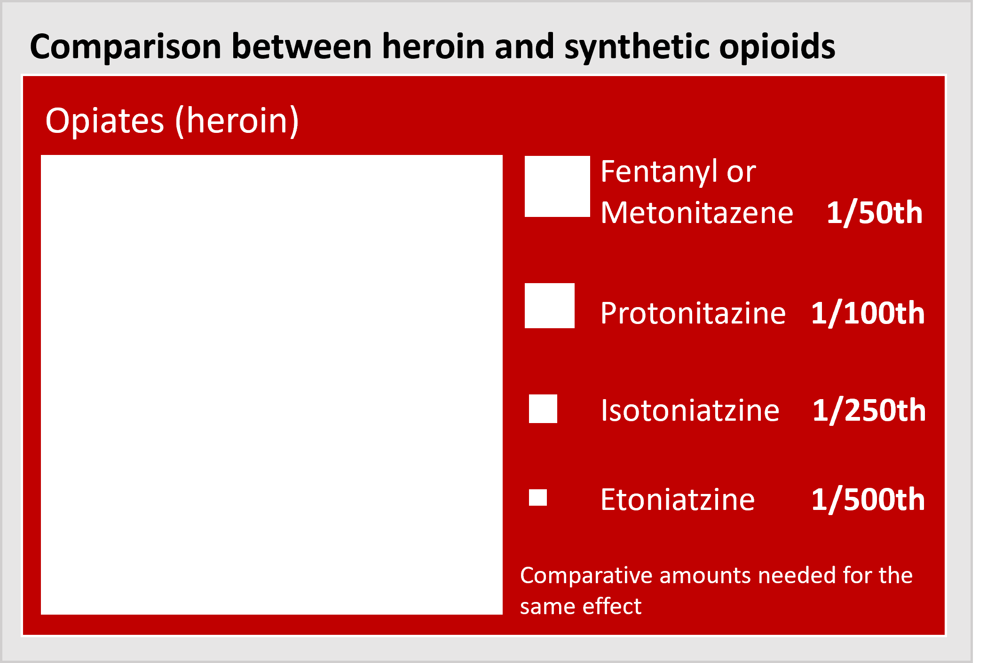


Synthetic Opioids Bulletin – March 2025
Synthetic opioids – Nitazenes and Fentanyls
Nitazenes and Fentanyls are synthetic opiates which are becoming more prevalent in the UK illicit drug supply.
Opiate production in Afghanistan has decreased by 90% since 2023 [1].
This has led to drug markets being adulterated with synthetic iterates, mostly from China, with supplies being ‘cut’ with cheaper, more potent drugs, often unknown to the user.
Nitazenes: Manufactured in laboratories and relatively cheap to make, Nitazenes can range from tens to many hundreds of times more potent than morphine. These can be up to 500 times stronger than street heroin and as with morphine and heroin, Nitazenes suppress the respiratory system, which can result in death however, the fatal effects of Nitazenes are seen at much lower doses. [2]
Nitazenes have also been detected in cocaine and synthetic cannabis, known commonly as ‘spice’, as well as counterfeit medicines, including benzodiazepines and oxycodone.
Fentanyl is a strong opioid painkiller used to treat severe pain. It is 30 to 50- times more potent than heroin and 50-100 times more potent than morphine. It is increasingly being found in illicit drug supplies.
Greenwich
Since September 2023 there have been 9 confirmed fatal overdoses in Greenwich, with several more nonfatal incidents reported between September 2023 and February 2025. In all but 5 cases in Greenwich Nitazenes were found to be present. Nationally, 173 deaths have been linked to synthetic opioids by the National Crime Agency between June 2023 and May 2024. [3]
London
The NCA reports 18 deaths in London for the same period, and in March 2025 there were 32 confirmed nonfatal overdoses in Camden with Nitazenes believed to be the cause.
Responding to emerging threats
In response to this emerging issue, all local authority partnerships, across the UK, including Greenwich, have moved to ensure Naloxone kits (an overdose reversal drug) are being supplied to those that need them, and are also providing harm reduction advice to known drug users.
Additionally; overdose training has been provided to over 200 practitioners in Greenwich. This training is free and online.
Greenwich has also developed a Synthetic Opioid Response Plan - see next page
173
18
Deaths linked to Nitazenes in the UK
Between June 2023 and May 2024
Deaths linked to Nitazenes in London Between June 2023 and May 2024
Notes:
Everything you need to know about nitazenes - The Pharmaceutical Journal
Deaths linked to potent synthetic opioids - GOV.UK

Slide 2
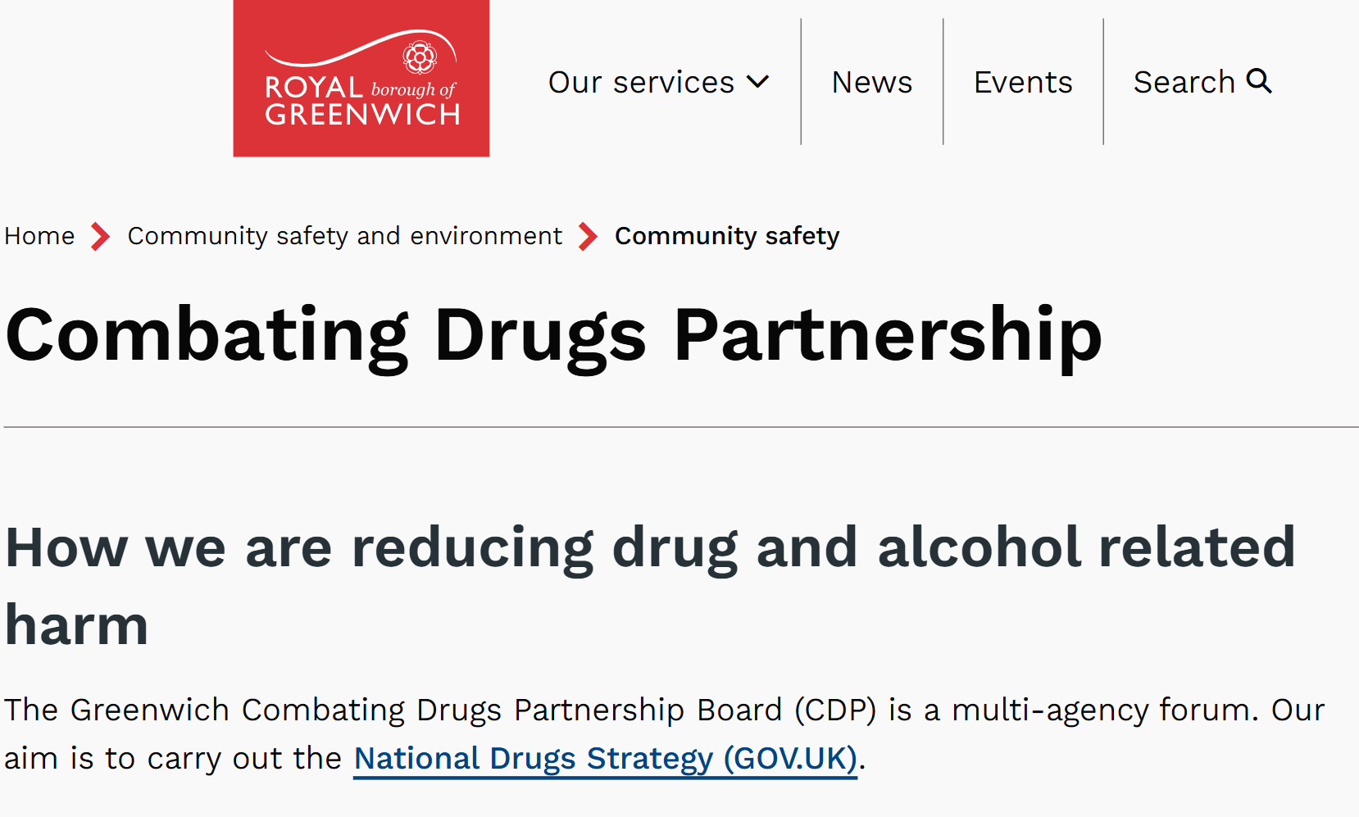
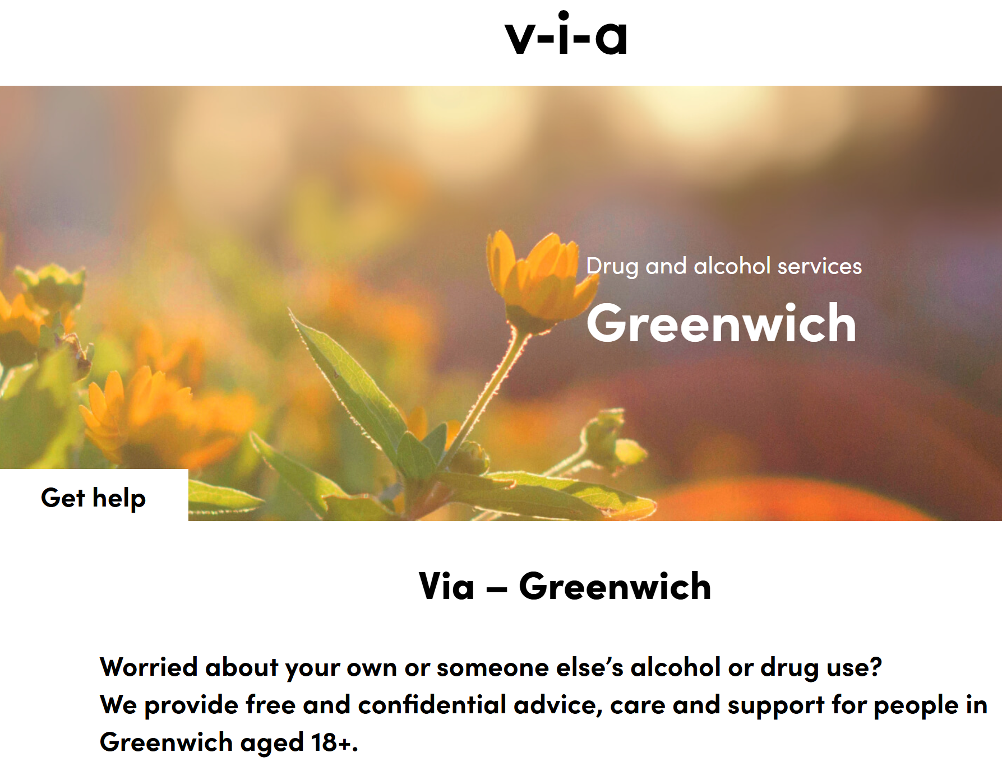
Synthetic Opioid Response Plan
Greenwich synthetic opioid response plan - SORP
The response plan is a partnership approach to deliver targeted support, harm reduction and preventative interventions to mitigate potential fatalities in the drug using population in Greenwich. If you would like to know more about the Greenwich Synthetic Opioid Response Plan, please visit the RBG website to download a copy: Combating Drugs Partnership documents | Royal Borough of Greenwich
Harm reduction advice for users
Never use alone, always ensure you have someone with you
Stagger your dose
Start low, go slow - Start with a lower dose and wait for the peak effects to pass
Always carry naloxone (overdose reversal agent) with you. You can get naloxone kits from Via Greenwich: 0300 303 4552
Get a substitute prescription – if you're using every day, call Via and get help with your drug use.
Naloxone Training
You can call Via on 0300 303 4552, training is free to anyone using drugs, and those supporting them, including practitioners.
More information on training, signs of overdose and what to do, click the link: Naloxone - via
Where to get treatment and support – advice for drug users needing support
If you need support for drug or alcohol use and would like to access free and confidential help, you can contact the Via Greenwich service on: 0300 303 4552
If you would like to know more, click the link: Drug & Alcohol Services in Greenwich | Via
How to make a referral
Practitioners can make a referral to Via Greenwich using the online referral form.
Please ensure you have the client's permission to share information, and you have signed consent to do so.
You can access the online referral tool on the Via Greenwich website Greenwich Referral – via
You may also make a referral by phone: 0300 303 4552, or email by completing the referral form and sending to: greenwich@viaorg.uk
Click image to go to website
Click image to go to website
Notes:
Everything you need to know about nitazenes - The Pharmaceutical Journal
Deaths linked to potent synthetic opioids - GOV.UK

Slide 3
Professionals Information Network - Drug Alerts
If you wish to be included in local drug alerts for Greenwich please contact:
drug.alerts@royalgreenwich.gov.uk
Local drug information system - LDIS
The Greenwich combating drugs partnership has a professionals information network for sharing updates on drug intelligence and distributing local drug alerts through the Local Drug Information System – LDIS.
We encourage all frontline practitioners to report any incidents so that we may be better prepared to respond to emerging overdose events linked to adulterated drug supplies in Greenwich.
If you have information or wish to alert the LDIS of an incident e.g. overdose incidents (fatal or nonfatal), or reports of contaminated drug supplies, you can complete the LDIS form on the combating drugs partnership page and send to drug.alerts@royalgreenwich.gov.uk
If you wish to be included in the local drug information system, please contact: drug.alerts@royalgreenwich.gov.uk
Click image to go to website
References:
1. Understanding the Implications of the Taliban’s Opium Ban in Afghanistan | Afghanistan peace campaign
2. Everything you need to know about nitazenes - The Pharmaceutical Journal
3. Deaths linked to potent synthetic opioids - GOV.UK
Websites:
Royal Borough of Greenwich – Combating Drugs Partnership
How we are reducing drug and alcohol related harm | Combating Drugs Partnership | Royal Borough of Greenwich
Via Greenwich Treatment Services
Drug & Alcohol Services in Greenwich | Via
If you would like to discuss the information in this bulletin, please contact
John McGirr – Senior Public Health Manager, Drugs, Alcohol, and Gambling: john.mcgirr@royalgreenwich.gov.uk
Click image to go to website

